Slide 1
Predicting Renewals
Problem Statement: To predict subscription renewals of Red Hat products.
Dataset:
      Dummy renewal information for 690 renewals
      .Contains 15 anonymized fields
      6 continuous fields and 9 categorical fields
Steps followed for building classification model.
Missing Value Treatment
Outlier detection and treatment
Feature Engineering
Prediction Models and Evaluation
Summary
Preparation and Data Exploration

Slide 2
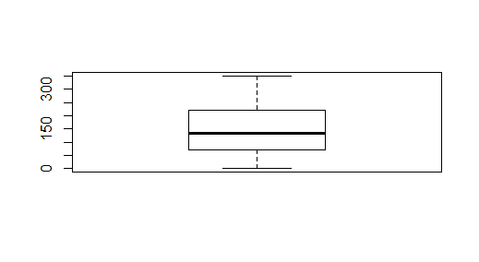
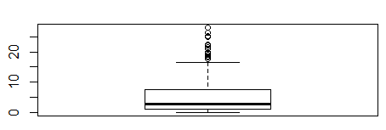
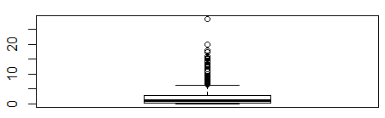
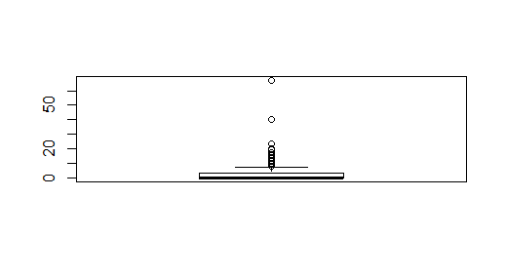
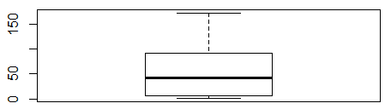
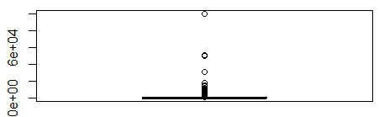
Cleaning and Preparation
  ‘?’ were mapped to NAs for ease of evaluation.
  Number of 0s in continuous field were significant, so treated as real value
  Continuous variables were de-factorized.
Boxplot for Continuous Variables
C2
C3
C8
C11
C14
C15
Fields C3, C8, C11 and C15 contains outliers whereas c2 and c14 don’t have any outliers

Slide 3
Analysis for Categorical Variables
  C1 - 2 levels: a:203, b:405
  C4 - 4 levels: l:2, u:499, y:152
  C5 - 3 levels: g:499, gg:2, p:152
  C6 - 14 levels: c:133, q:75, w:63, i:55, aa:52, ff:50, other:225
  C7 - 9 levels: v:381, h:137, ff:54, bb:53, j:8, z:8, other:12
C9 - 2 levels: f:304, t:349
C10 - 2 levels: f:366, t:287
C12 - 2 levels: f:351, t:302
C13 - 3 levels: g:598, p:2, s:53
Most of the fields are not equally distributed among their levels.
Correlation between various continuous variables
 | C2 | C3 | C8 | C11 | C14 | C15
C2 | 1 | 0.160932 | 0.409939 | 0.191817 | -0.06339 | 0.030454
C3 | 0.160932 | 1 | 0.3006 | 0.269834 | -0.09765 | 0.119754
C8 | 0.409939 | 0.3006 | 1 | 0.327325 | -0.02428 | 0.052159
C11 | 0.191817 | 0.269834 | 0.327325 | 1 | -0.04869 | 0.058408
C14 | -0.06339 | -0.09765 | -0.02428 | -0.04869 | 1 | 0.061758
C15 | 0.030454 | 0.119754 | 0.052159 | 0.058408 | 0.061758 | 1
The correlation values between the continuous variables are less than 0.5
The fields are independent of each other

Slide 4
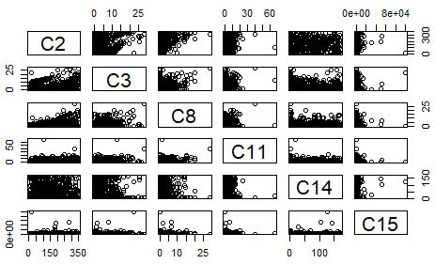
There are a few outliers in some of the plots:
  C2 vs C3
  C2 vs C11
  C2 vs C15
  C3 vs C8
  C3 vs C11
  C3 vs C15
  C8 vs C11
C8 vs C15
C11 vs C14
C11 vs C15
C14 vs C15
Bivariate Analysis for Categorical Variables
  Most of the variables are not independent of each other as the probability in Chi-Square test is less than 0.5.
  A few pair have probability more than 0.5 : C12 – C13, C8 – C13
  C9, C10 and C12 are highly correlated as their p-values are nearly equal to zero.

Slide 5
Missing value treatment
Out of the 690 observations 37 have missing values in one or more fields.
As the fields are anonymized so imputation is not feasible and just 5% of observations have missing values.
So observations with missing values were dropped from the dataset.
Final Dataset has 653 observations
Outliers treatment
The outlier extraction from the boxplot of all the continuous variables produced 184 unique rows.
All the continuous variables expect C2(no outliers and perfectly symmetric) were log transformed.
After the treatment the number of outliers were reduced to 73.
These outliers were not deleted or imputed as there is no information about the fields and their source
Feature Engineering
All the 9 categorical variables were Level Encoded to replace the different levels with numerical values.
Level Encoding makes the dataset ready for prediction modelling.
New variable were not derived as there is no information regarding the attributes and their significance

Slide 6
Results of t-test
Fields p-value
C1 0.61378
C2 5.09E-06
C3 0.011912
C4 2.48E-06
C5 8.08E-06
C6 0.001909
C7 0.777817
C8 1.66E-10
Fields p-value
C9 3.10E-117
C10 1.97E-33
C11 8.69E-36
C12 0.20217
C13 0.007914
C14 0.084791
C15 5.40E-06
All fields except C1, C7, C12 and C14 are not significant according to the statistical t-test(p<0.05)
Results of Classification Models*
Model | With all attributes |  |  |  | With significant(p<0.05) attributes
 | Accuracy | Sensitivity | Specificity | AUC-ROC | Accuracy | Sensitivity | Specificity | AUC-ROC
Logistic Regression | 84.73% | 77.03% | 94.74% | 85.88% | 83.97% | 75.68% | 94.74% | 85.21%
SVM | 83.2% | 74.3% | 94.74% | 84.53% | 83.21% | 74.32% | 94.74% | 84.53%
Random Forest | 86.26% | 82.43% | 91.23% | 86.83% | 84.73% | 81.08% | 89.47% | 85.28%
Training the model with statistically significant variables doesn't improves the model.
Random Forest trained with all the fields gives the highest accuracy as it’s a non – linear model.
*The final dataset is divided into train and test dataset in 8.:20 ratio. Models are trained using train and evaluated using test dataset

Slide 7
Justification for the models
  Logistic Regression, SVM and Random Forest are used as the dependent variable is categorical in nature.
Justification for chosen accuracy measure
  The prediction attribute is categorical, so confusion matrix and AUC-ROC are the best metrics for model evaluation
Steps for further improvement of model
Imputation of missing values using KNN for all the variables
Outlier detection using K-means clustering .
Outlier imputation using KNN.
ANOVA test between categorical and continuous variable to check independence
By looping over the following steps - Missing values treatment, Outlier treatment, Variable transformation, Variable creation.
K – fold cross validation for classification models

